Slide 1
PNEUMONIA DETECTION USING CHEST X-RAYS.

Slide 2
Introduction.
What is pneumonia?
Pneumonia is a disease of the lungs and the respiratory system.
Pneumonia can be caused by bacteria, virus, fungi or parasites. It can also be caused by chemical or physical damage done to the lungs. Other illnesses, like alcohol abuse or lung cancer, can also result in pneumonia.
People with pneumonia usually have difficulty breathing. They may also cough, or have pains in the chest area. The treatment of pneumonia depends on how the illness was caused. If it was caused by bacteria, antibiotics can be used to treat it.
Pneumonia accounts for 15% of all deaths of children under 5 years old, killing 808,694 children in 2017 according to World Health Organisation.
Risking Factors:
Pre-existing illnesses, such as symptomatic HIV infections and measles, also increase a child's risk of contracting pneumonia.
The following environmental factors also increase a child's susceptibility to pneumonia:
indoor air pollution caused by cooking and heating with biomass fuels (such as wood or dung)
living in crowded homes
parental smoking.

Slide 3
Business Understanding.
The main reason for this research is to detect pneumonia at an early stage using Artificial Intelligence based systems.
Methodology used:
Transfer Learning.

Slide 4
Transfer Learning.
-Transfer learning is the improvement of learning in a new task through the transfer of knowledge from a related task that has already been learned.
- In transfer learning, we first train a base network on a base dataset and task, and then we repurpose the learned features, or transfer them, to a second target network to be trained on a target dataset and task. This process will tend to work if the features are general, meaning suitable to both base and target tasks, instead of specific to the base task.
Approach used: Pre-trained Model Approach
Select Source Model. A pre-trained source model is chosen from available models. Many research institutions release models on large and challenging datasets that may be included in the pool of candidate models from which to choose from.
Reuse Model. The pre-trained model can then be used as the starting point for a model on the second task of interest. This may involve using all or parts of the model, depending on the modeling technique used.
Tune Model. Optionally, the model may need to be adapted or refined on the input-output pair data available for the task of interest.

Slide 5
Setup.
Google Colaboratory(a.k.a Colab) is a powerful platform for learning and computing methods learnt by developing machine learning models. It supports collaborative . Notebooks can be shared on Github for public viewing. Colab supports many machine learning and deep learning libraries such as Tensorflow, Keras, Pandas, Numpy, and Opencv.

Slide 6
Softwares and libraries used:
Python based cloud environment using Google Collaboratory
Data stored on Google Drive
Python Libraries – Pandas, Numpy, Tensorflow, Keras, matplotlib, sklearn and seaborn
Evaluation : Accuracy Plot, Loss Plot

Slide 7
Data understanding.
The Chest X-ray dataset was downloaded from Kaggle. The dataset had 3 folders: train, test and validation.
Train : 5216
Test : 624
Validation : 16

Slide 8
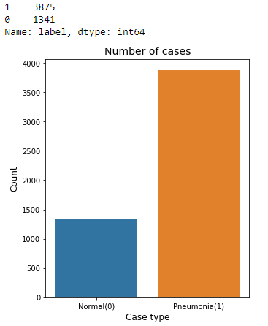
Number of classes in train data. Pneumonia and Normal.

Slide 9
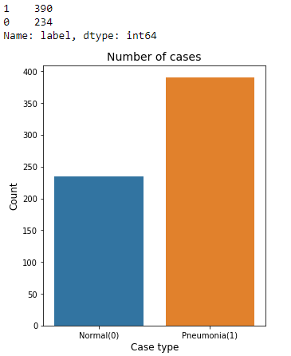
Test data classes: pneumonia and normal.

Slide 10
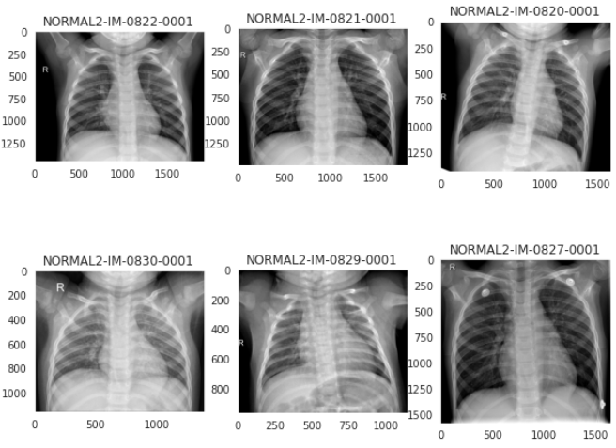
Normal x-ray samples from train data.

Slide 11
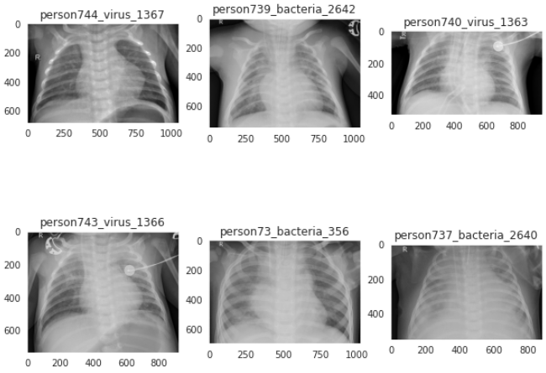
Pneumonia x-ray samples from train data.

Slide 12
Handling imbalanced training data.
Weight balancing: balances our data by altering the weight that each training example carries when computing the loss. Normally, each example and class in our loss function will carry equal weight i.e 1.0. But sometimes we might want certain classes or certain training examples to hold more weight if they are more important.
weight_for_0 = (1 / count_normal)*(len(train_images))/2.0
weight_for_1 = (1 / count_pneumonia)*(len(train_images))/2.0
class_weight = {0: weight_for_0, 1: weight_for_1}

Slide 13
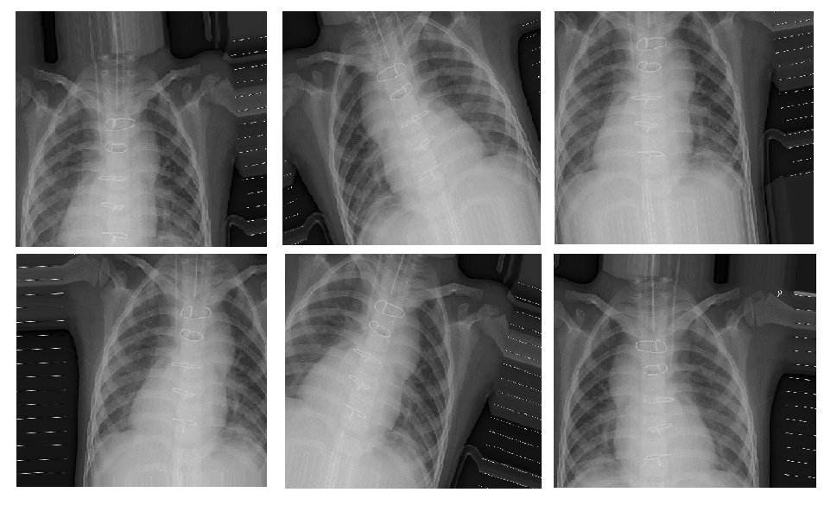
Data Preprocessing : Image augmentation.
Purpose: The purpose was to resize the images and the process prevents overfitting as we are adding more data.
Rescale.
Rotation.
Zoom range.
Width and
Height shift
range.

Slide 14
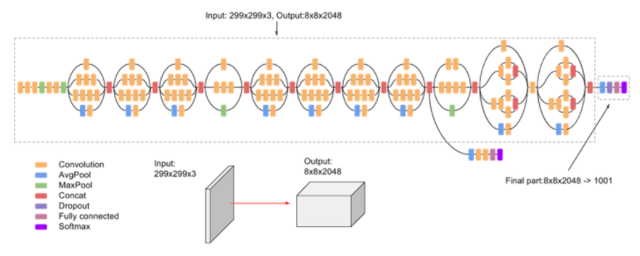
Modelling.
The models used where:
InceptionV3 - is a convolutional neural network architecture from the Inception family that makes several improvements including using Label Smoothing, Factorized 7 x 7 convolutions, and the use of an auxiliary classifier to propagate label information lower down the network (along with the use of batch normalization for layers in the side head).

Slide 15
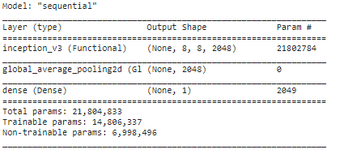
InceptionV3.
Model accuracy:
loss rate at evaluation data : 0.1696
accuracy rate at evaluation data : 0.9504

Slide 16
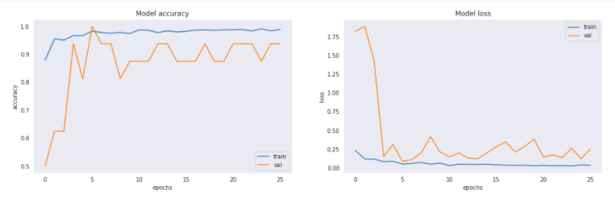
Plotting of the accuracy and loss against number of epochs.

Slide 17
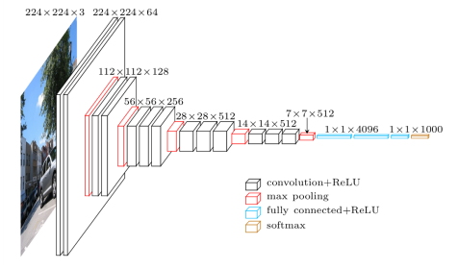
2. VGG-16 - The most unique thing about VGG16 is that instead of having a large number of hyper-parameter they focused on having convolution layers of 3x3 filter with a stride 1 and always used same padding and maxpool layer of 2x2 filter of stride 2. It follows this arrangement of convolution and max pool layers consistently throughout the whole architecture. In the end it has 2 FC(fully connected layers) followed by a softmax for output. The 16 in VGG16 refers to it has 16 layers that have weights. This network is a pretty large network and it has about 138 million (approx) parameters.

Slide 18
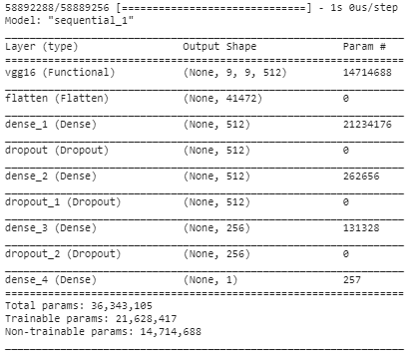
VGG-16.
Model accuracy:
loss rate at evaluation data : 0.1906
accuracy rate at evaluation data : 0.9199

Slide 19
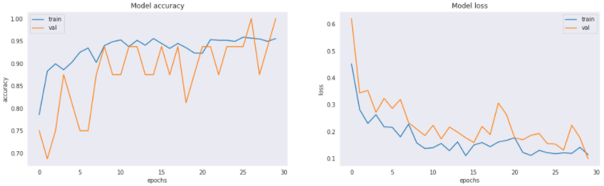
Plotting of the accuracy and loss against number of epochs.

Slide 20
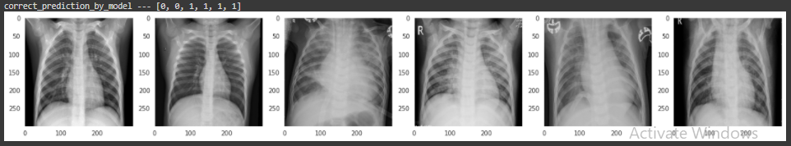
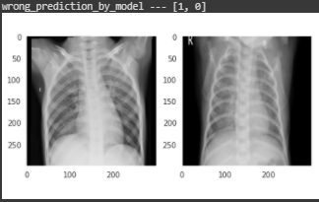
Prediction on test using InceptionV3.

Slide 21
Challenges.
Model where taking too much time to run and sometimes the computer would go off.
How to go about it.
Mouse and keyboard automation.

Slide 22
Thank you.

